Slide 1
Layout Analysis and Reconstruction
jan.schulz@devugees.org

Slide 2
Agenda
Google
Bing
YouTube
Twitter

Slide 3
Feedback Assignment
First Group
Started colouring + effecting the elements first
Second Group
Started positioning + aligning the elements first

Slide 4
Feedback Assignment
First Group
Started colouring + effecting the elements first
Second Group
Started positioning + aligning the elements first
Second Group has the better approach!
Divide & Conquer!

Slide 5
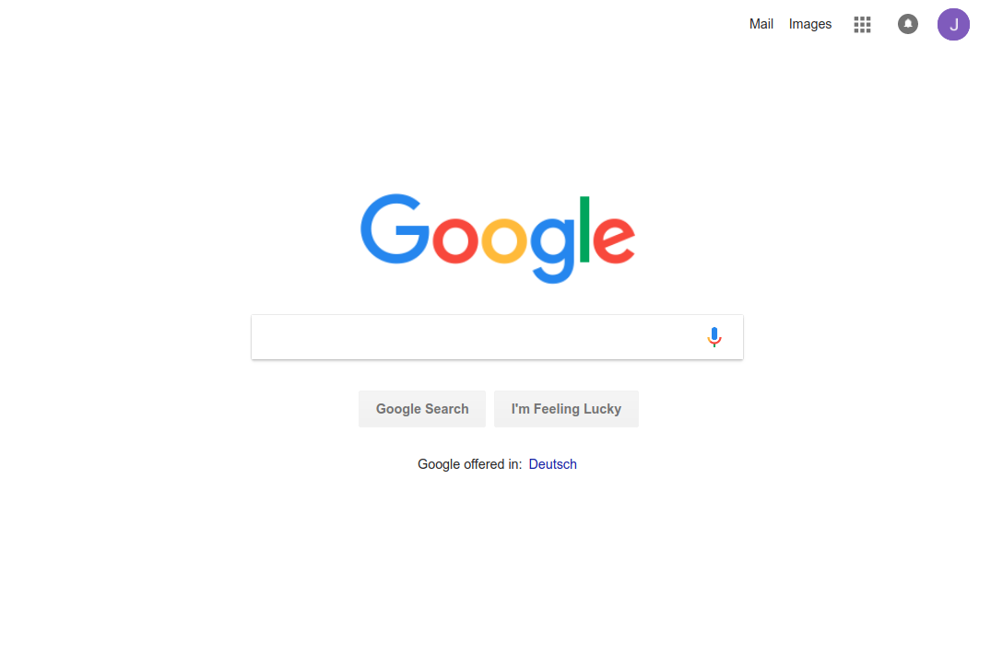
1. Google - Mobile

Slide 6
1. Google - Mobile
HEADER
NAVIGATION
MAIN
LOGO
SEARCH BOX
SEARCH BTN
LUCYK BTN
IMPRINT

Slide 7
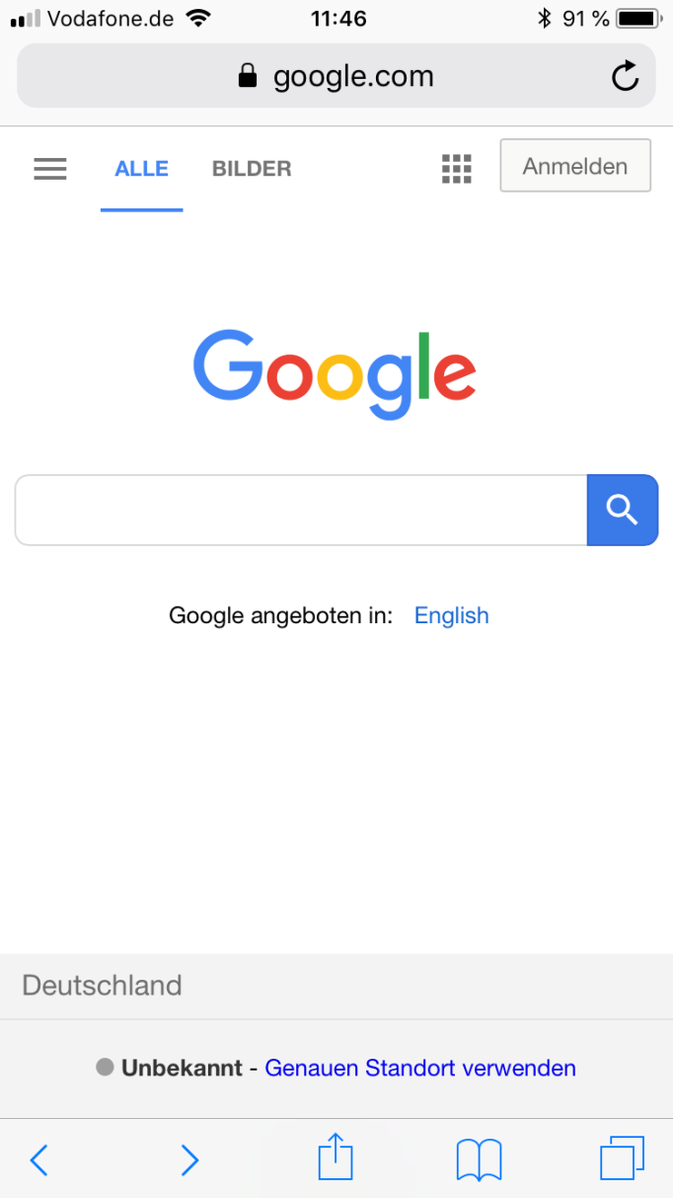
1. Google - Desktop

Slide 8
1. Google - Desktop
MAIN
NAVIGATION
LOGO
SEARCH BOX
B
IMPRINT
LOCATION

Slide 9
Task:
Analyze the following websites using Chrome Devtools and your abstraction skills!
Take a pencil and a sheet of paper and illustrate a graphical concept of the fundamental parts of each website!

Slide 10
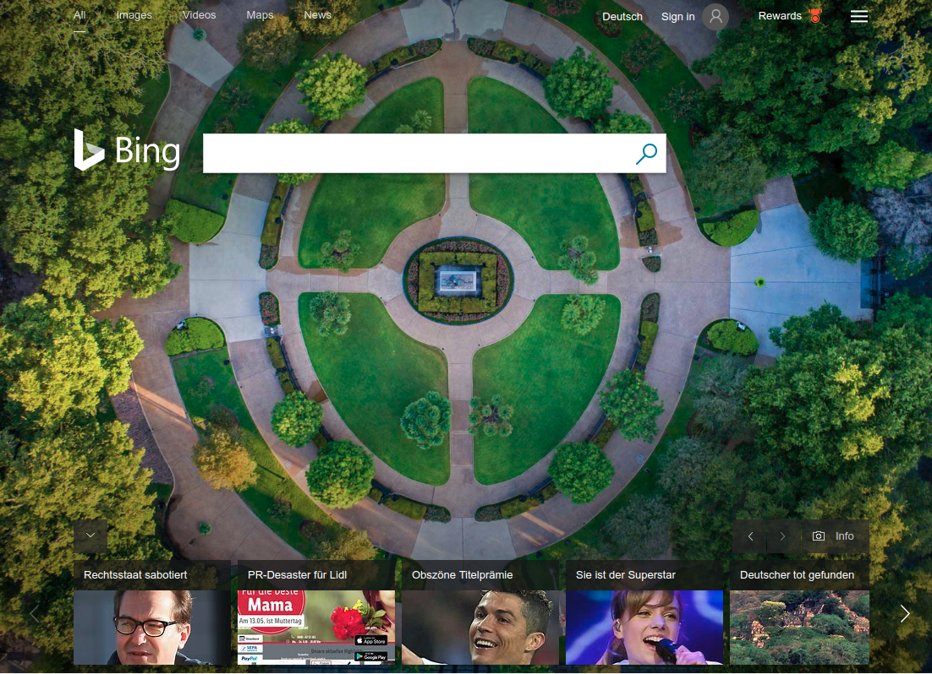
2. Bing

Slide 11
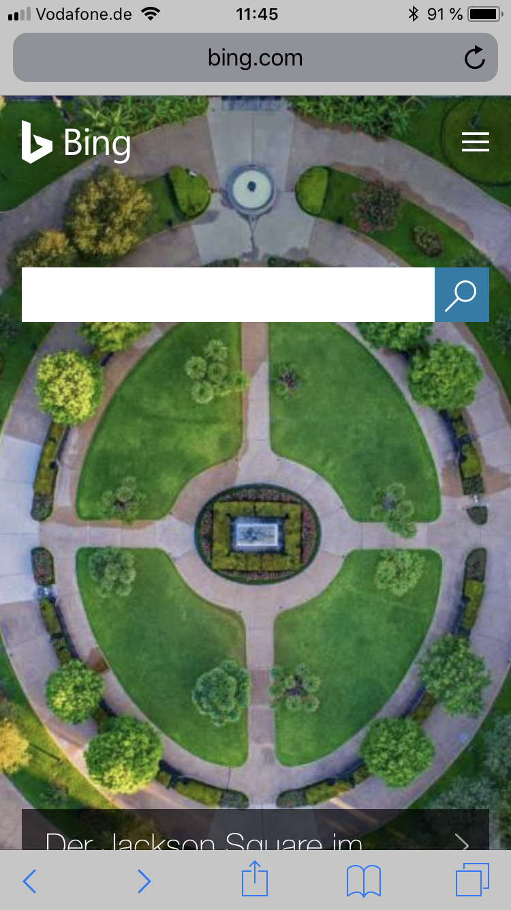
2. Bing

Slide 12
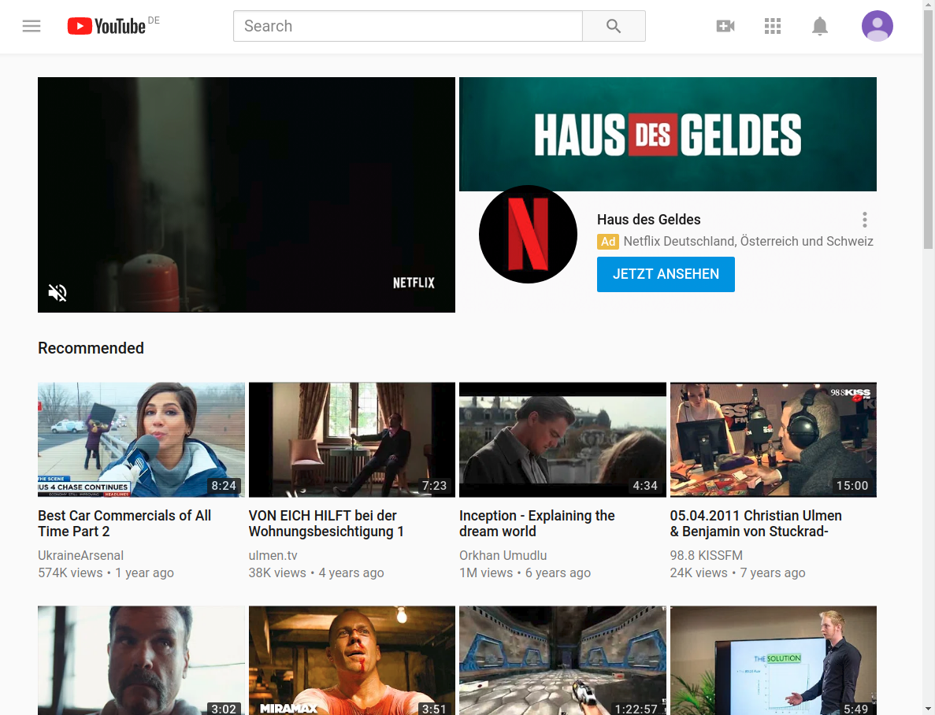
3. YouTube

Slide 13
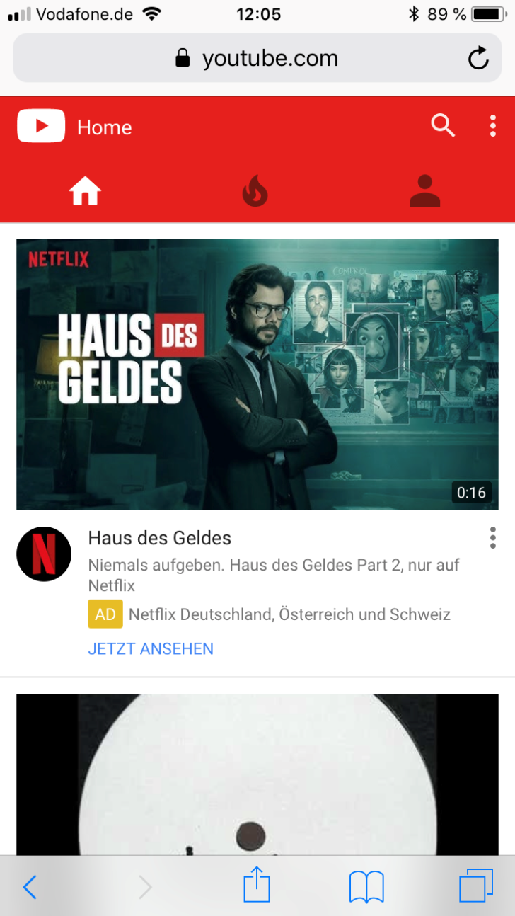
3. YouTube

Slide 14
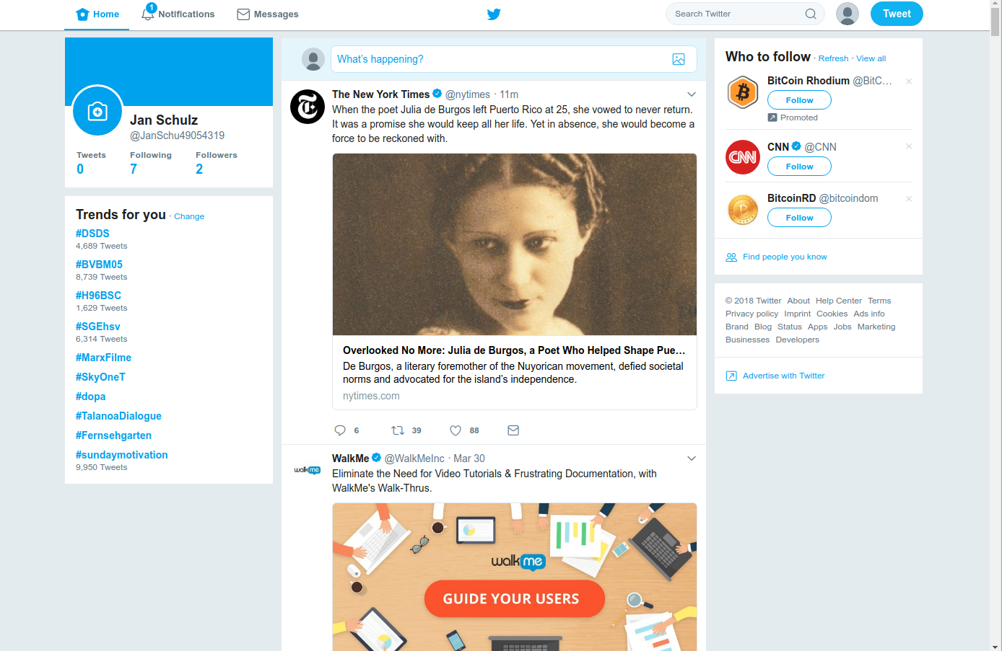
4. Twitter

Slide 15
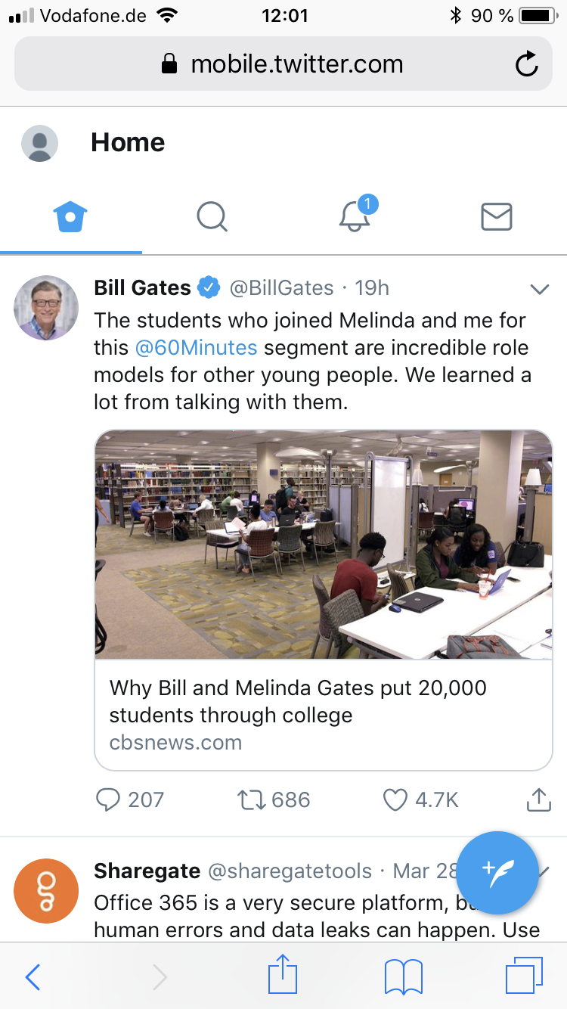
4. Twitter

